Slide 1
Point Cloud Basics & ML Exploration
Dileep Gadiraju
https://github.com/dileep-gadiraju/point-cloud-exploration

Slide 2
Topics
What is Point Cloud?
How is Point Cloud Captured?
Point Cloud Use cases
3D Raw Data Formats
Deep Learning on Point Cloud
What is PointNet ?
PointNet Use Cases
3D Open Dataset
Demo
How it all works together?

Slide 3
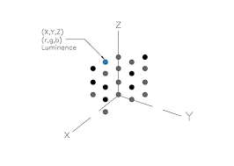
What is Point Cloud?
A point cloud is a unordered set of data points in space. The points may represent a 3D shape or object. Each point position has its set of Cartesian coordinates. Point clouds are generally produced by 3D scanners or by photogrammetry software, which measure many points on the external surfaces of objects around them.
Each point in Point Cloud consists of X , Y ,Z values with RGB and intensity.
Notes:
PointCloud - a raw 3D scan format.
Polygon Mesh
https://paperswithcode.com/method/pointnet
Point cloud is an important type of geometric data structure. They are simple and unified structures that avoid the combinatorial irregularities and complexities of meshes. These properties make point clouds widely used for 3D reconstruction or visual understanding applications, such as AR, autonomous driving, and robotics. This course will teach how we apply deep learning methods to point cloud data. We will cover the following topics in this short course and will end with some open problems.
• Basic neural architectures to process point cloud as input or to generate point cloud as output
• Scene-level understanding of static and dynamic point clouds
• Point cloud based inverse graphics
• Learning to convert point cloud to other 3D representations
• Learning to map point cloud with data in other modalities (images, languages)

Slide 4
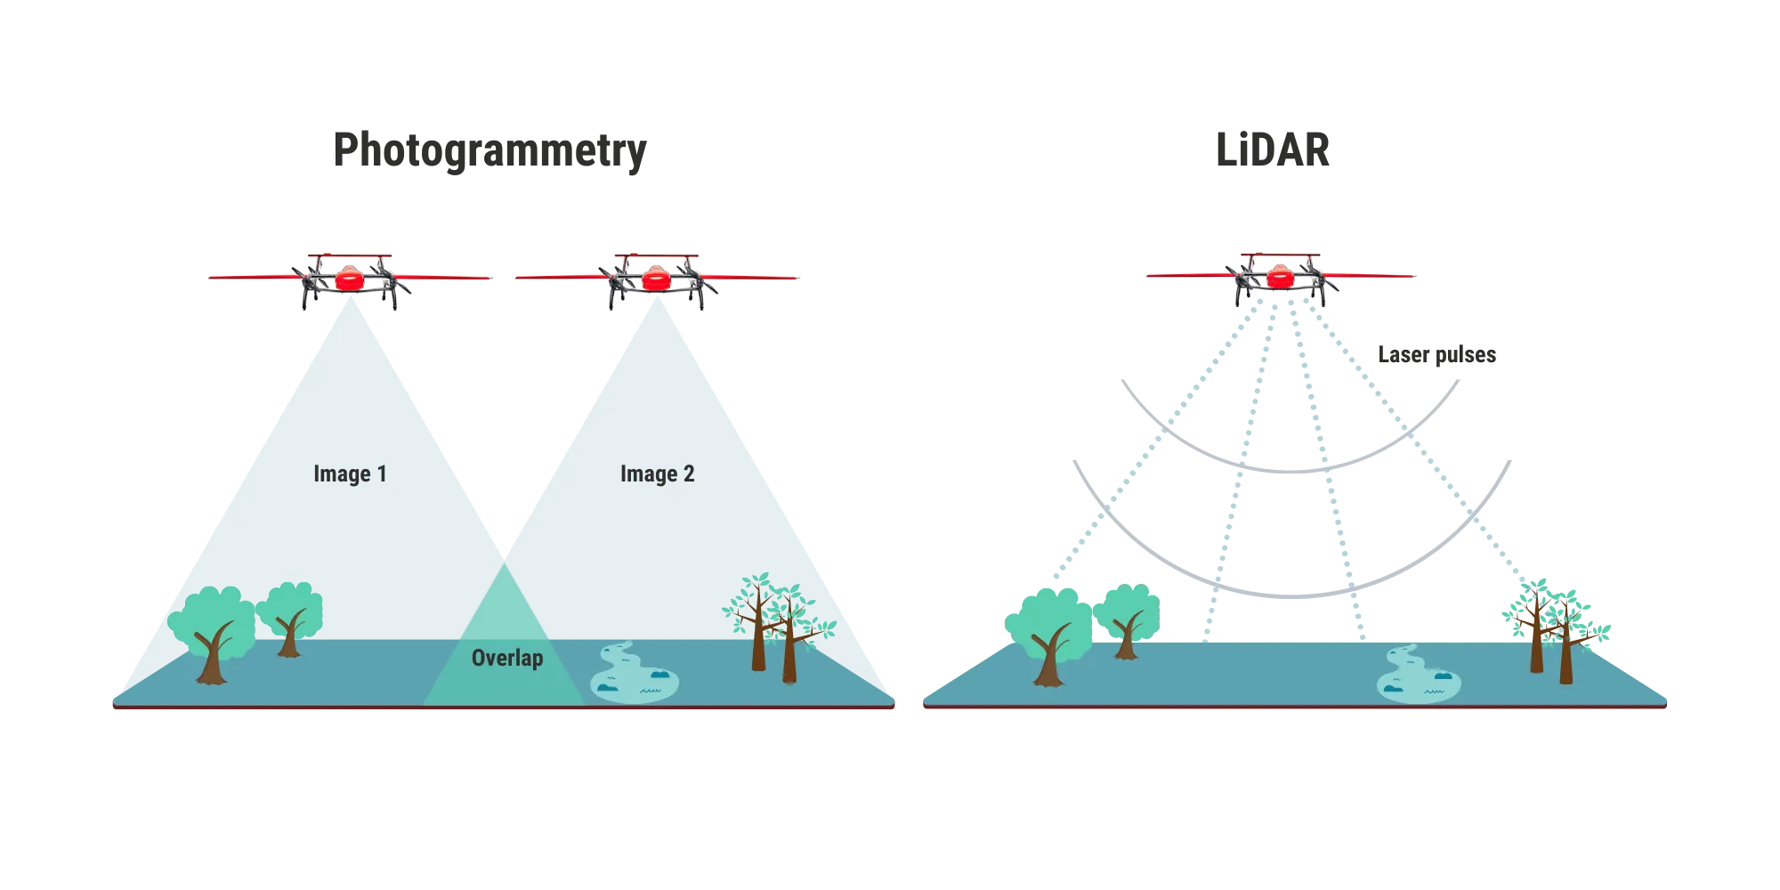
How is Point Cloud Captured ?
Two primary ways to capture Point Cloud:
LiDAR(Light Detection and Ranging)
Uses rapid laser pulses to gather hundreds of thousands of extremely accurate measurements per second. Generally speaking, laser scanners produce higher accuracy data than photogrammetry. Video : https://www.youtube.com/watch?v=fS3J4V_BgP0
Photogrammetry
To generate a point cloud with photogrammetry, you would cameras to capture the space from all angles, and then process those images with specialized software to reconstruct the space in 3D. Video : https://www.youtube.com/watch?v=ZIW4XU6Wm8Q
Notes:
PointCloud - a raw 3D scan format.
Polygon Mesh
https://paperswithcode.com/method/pointnet
iPhone 12 has LiDAR scanner
https://medium.com/spatial-data-science/what-is-lidar-point-cloud-data-a547ed29edf5
https://www.kaggle.com/datasets/kmader/point-cloud-segmentation

Slide 5
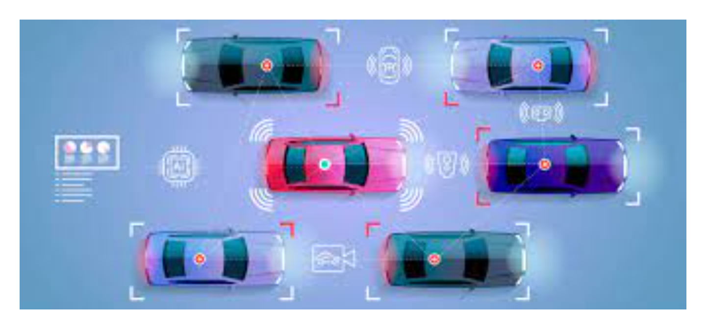
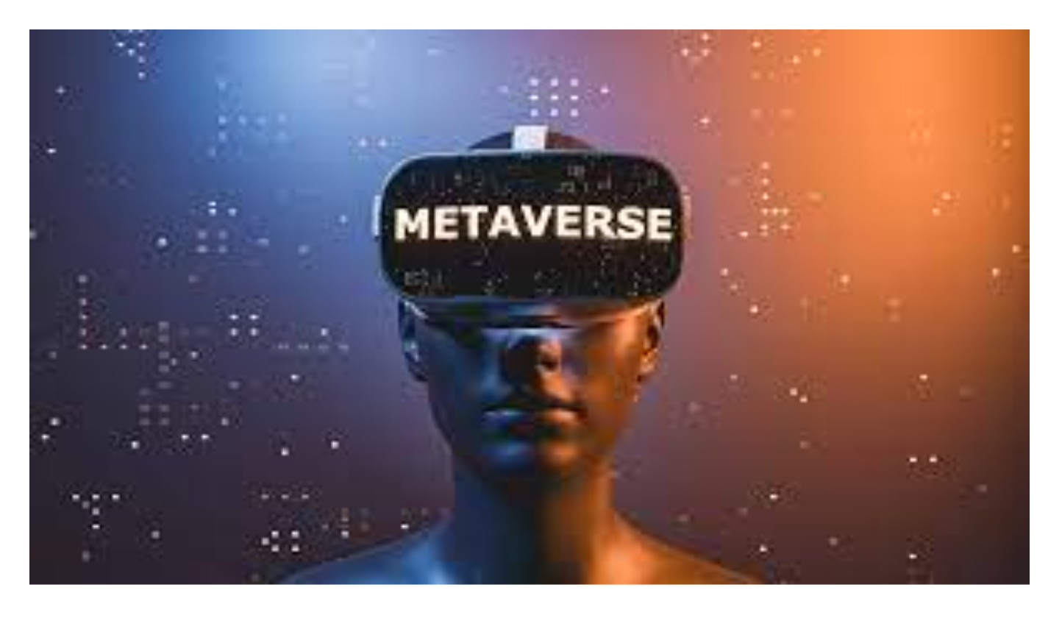
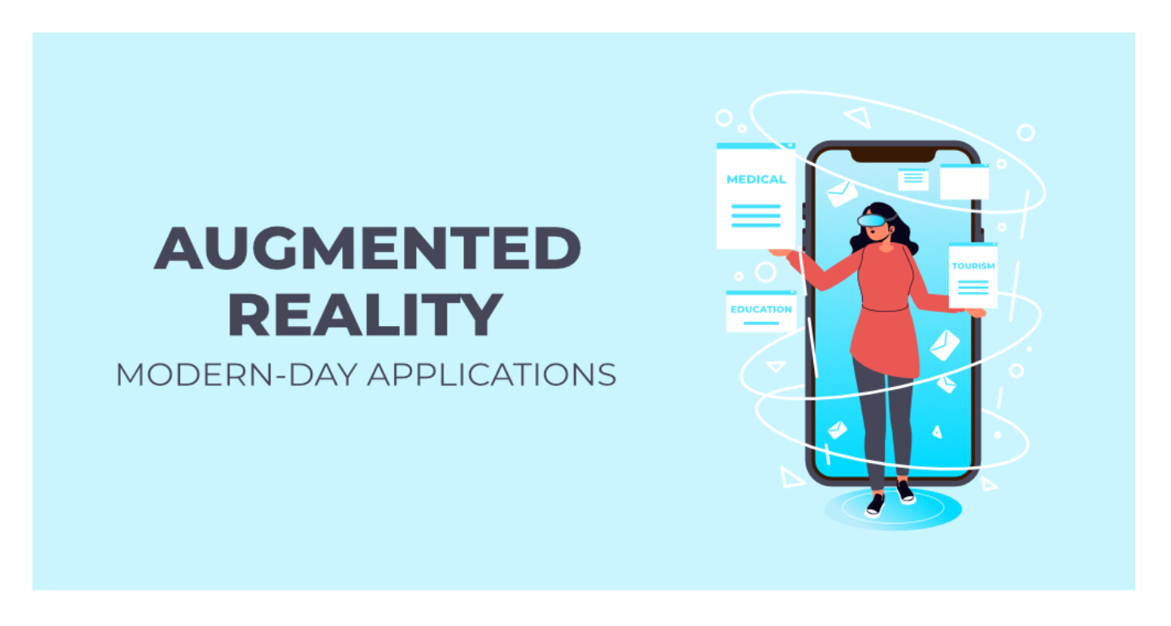
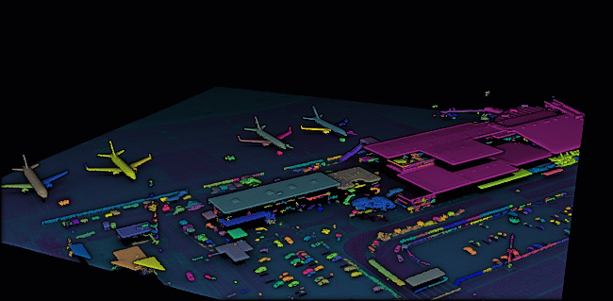
Point Cloud Use cases
Self-driving cars
Autonomous robots
Augmented Reality(AR)
Virtual Reality(VR)
Metaverse (metaverse is a network of 3D virtual worlds focused on social connection. Uses both AR + VR)
3D Instance Segmentation
Building renovation, reconstruction, refurbishment
Detailed understanding of design models

Slide 6
3D Raw Data formats
.XYZ files contain atomic coordinates
.PLY is a computer file format known as the Polygon File Format to store 3D data.
.LAS is a file format for the interchange of 3-dimensional point cloud data.
.OFF (Object File Format) is a geometry definition file format containing the description of the composing polygons of a geometric object
.PTS file is a plain text file that stores point data, typically collected using a LIDAR scanner
.GLTF (Graphics Language Transmission Format)
.GLB (Graphic Language Transmission Format Binary) GLTF Binary format.
Notes:
Common point cloud formats include PTS, PTX, XYZ, E57, PLY and LAS.
Colab Notebook to show different point cloud formats

Slide 7
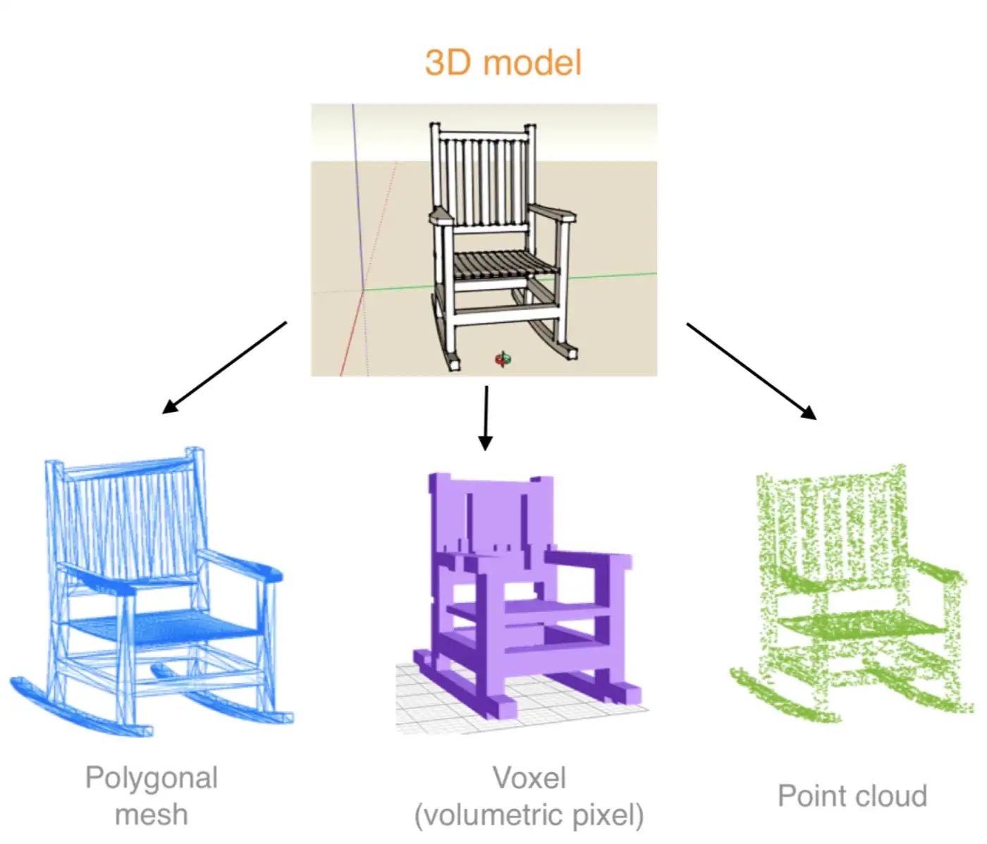
Deep Learning on Point Cloud
Point clouds are unordered. Algorithm has to be invariant to permutations of the input set.
Network should capture interactions among points.
Network must be invariant to rigid transformations (eg. different angles of an object or terrain).
Notes:
PointCloud - a raw 3D scan format.
Polygon Mesh
https://paperswithcode.com/method/pointnet
Point clouds are simple and unified structures that avoid the combinatorial irregularities and complexities of meshes, and thus are easier to learn from.

Slide 8
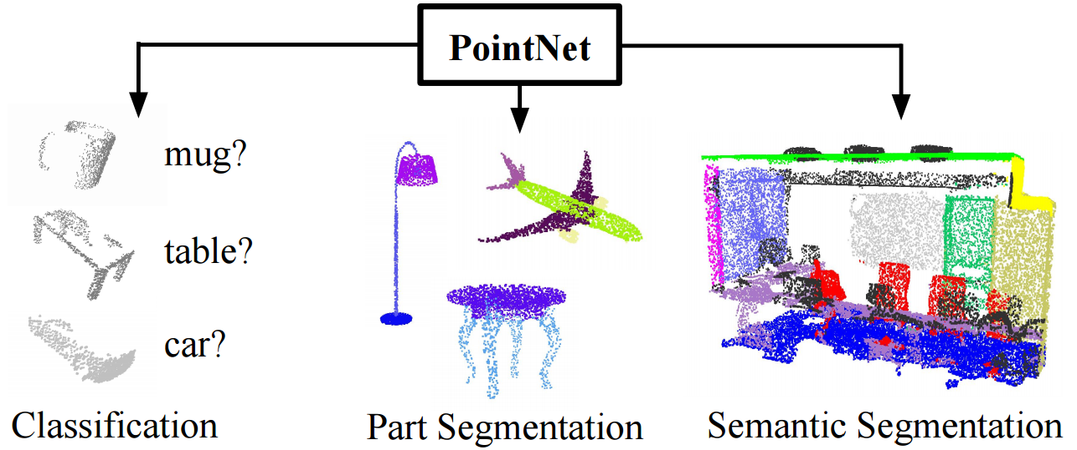
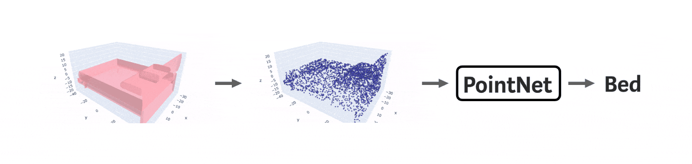
What is PointNet ?
PointNet provides a unified architecture for applications ranging from object classification, part segmentation, to scene semantic parsing.
It directly takes point clouds as input and outputs either class labels for the entire input or per point segment/part labels for each point of the input.
https://arxiv.org/abs/1612.00593
Notes:
https://www.youtube.com/watch?v=_py5pcMfHoc

Slide 9
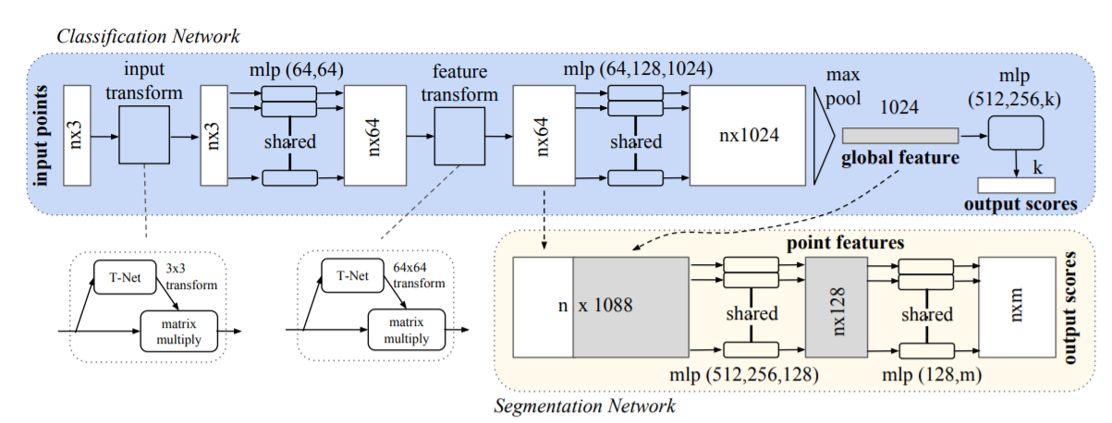
PointNet Architecture
Notes:
Classification Network: To classify object Chair , Mug , Table etc. Max Pool Symmetry Function for Unordered Input solves the problem of unordered points.
Segmentation Network: Labels each point as semantic label , identifies parts. Feed Global and local features to capture interaction among points.
T-Net: Solves the problem of Invariance under transformations
https://www.youtube.com/watch?v=_py5pcMfHoc

Slide 10
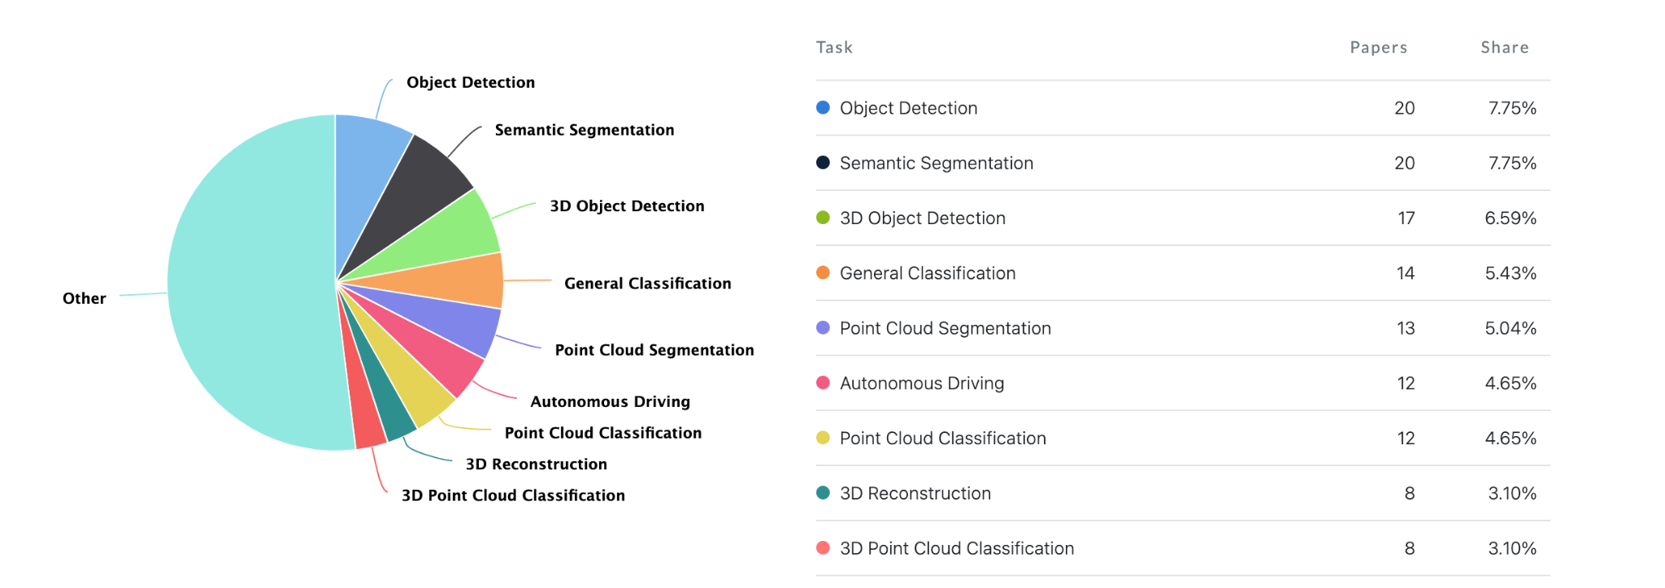
PointNet Use cases

Slide 11
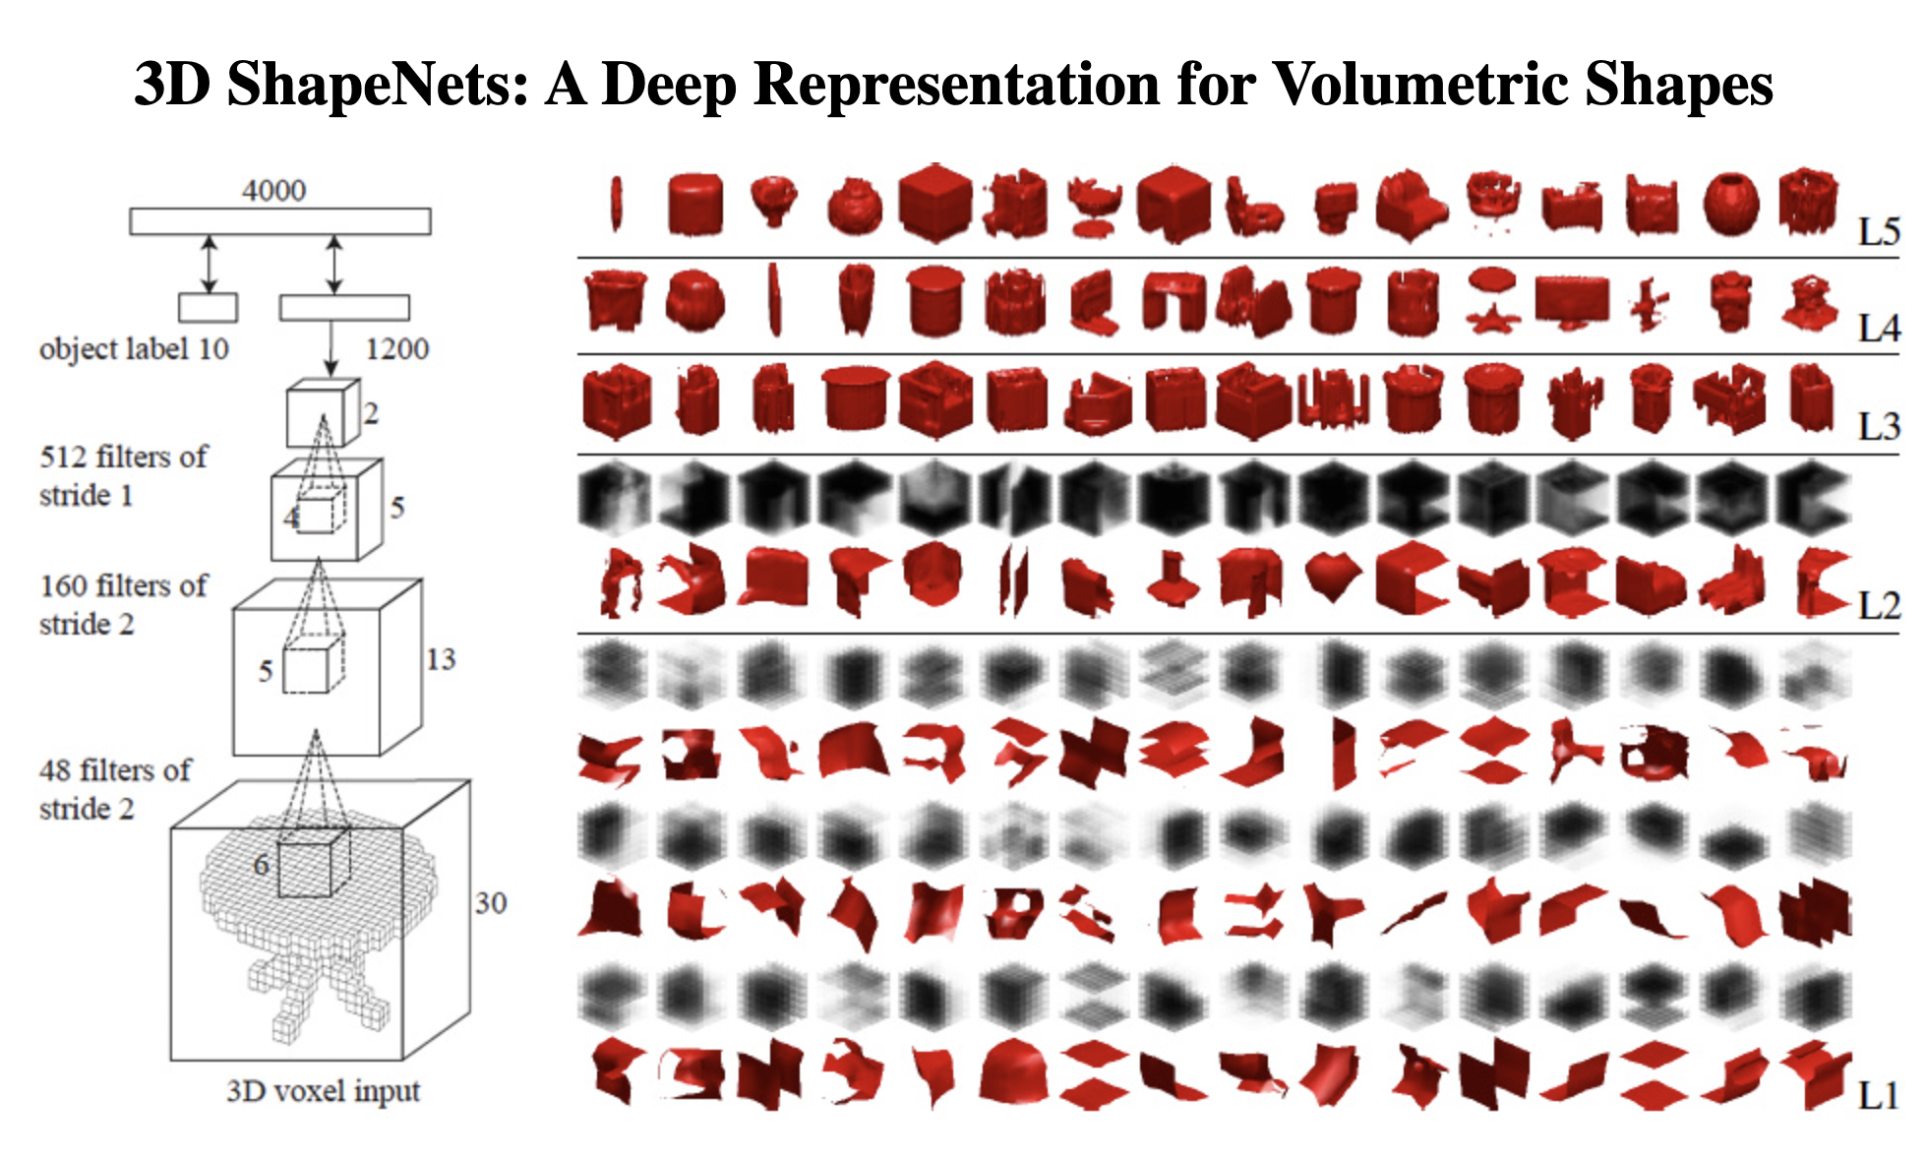
3D Open Dataset
ModelNet10 dataset
4,899 models
10 object categories/classes
3,991(80%) training and 908(20%) for testing
ModelNet40 dataset
12,311 pre-aligned shapes
40 Objects categories/classes
9,843 (80%) training and 2,468 (20%) for testing

Slide 12
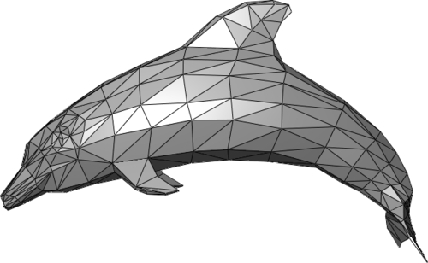
Trimesh library
Trimesh is a Python library for loading and using triangular meshes.
https://github.com/mikedh/trimesh
Notes:
TriMesh - Triangular Mesh is type of polygon mesh.
Colab Notebook to try TriMesh

Slide 13
Demo
Polycam,Widar and 3D Live Scanner mobile app
Classification with PointNet
Semantic Segmentation with PointNet

Slide 14
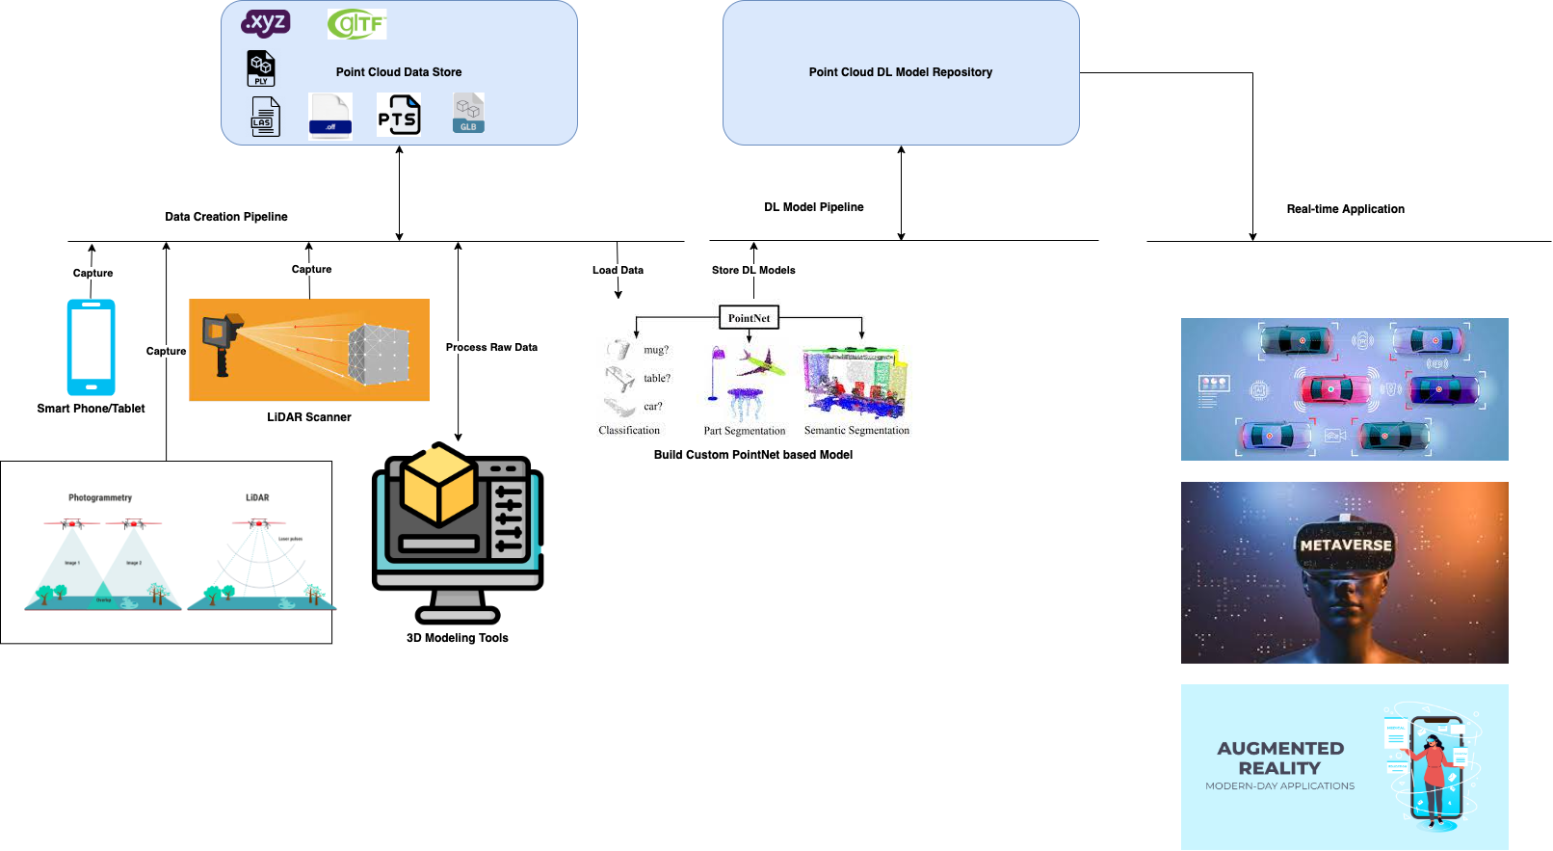
How it all works together?

Slide 15
Thank you!

